Slide 1
Introduction to POS Tagging
Pawan Goyal
CSE, IITKGP
Week 3: Lecture 4
Introduction to POS Tagging
Week 3: Lecture 4
‹#› / 18

Slide 2
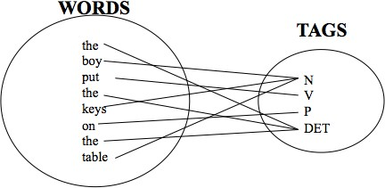
Part-of-Speech (POS) tagging
Task
Given a text of English, identify the parts of speech of each word
Introduction to POS Tagging
Week 3: Lecture 4
2 / 18

Slide 3
Parts of Speech: How many?
Open class words (content words)
nouns, verbs, adjectives, adverbs
mostly content-bearing: they refer to objects, actions, and features in the world
open class, since new words are added all the time
Closed class words
pronouns, determiners, prepositions, connectives, ...
there is a limited number of these
mostly functional: to tie the concepts of a sentence together
Introduction to POS Tagging
Week 3: Lecture 4
3 / 18

Slide 4
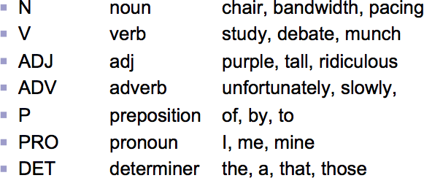
POS examples
Introduction to POS Tagging
Week 3: Lecture 4
4 / 18

Slide 5
POS tagging: Choosing a tagset
To do POS tagging, a standard set needs to be chosen Could pick very coarse tagsets
N, V, Adj, Adv
More commonly used set is finer grained, “UPenn TreeBank tagset”, 45 tags
A Nice Tutorial on POS tags
https://sites.google.com/site/partofspeechhelp/
Introduction to POS Tagging
Week 3: Lecture 4
5 / 18

Slide 6
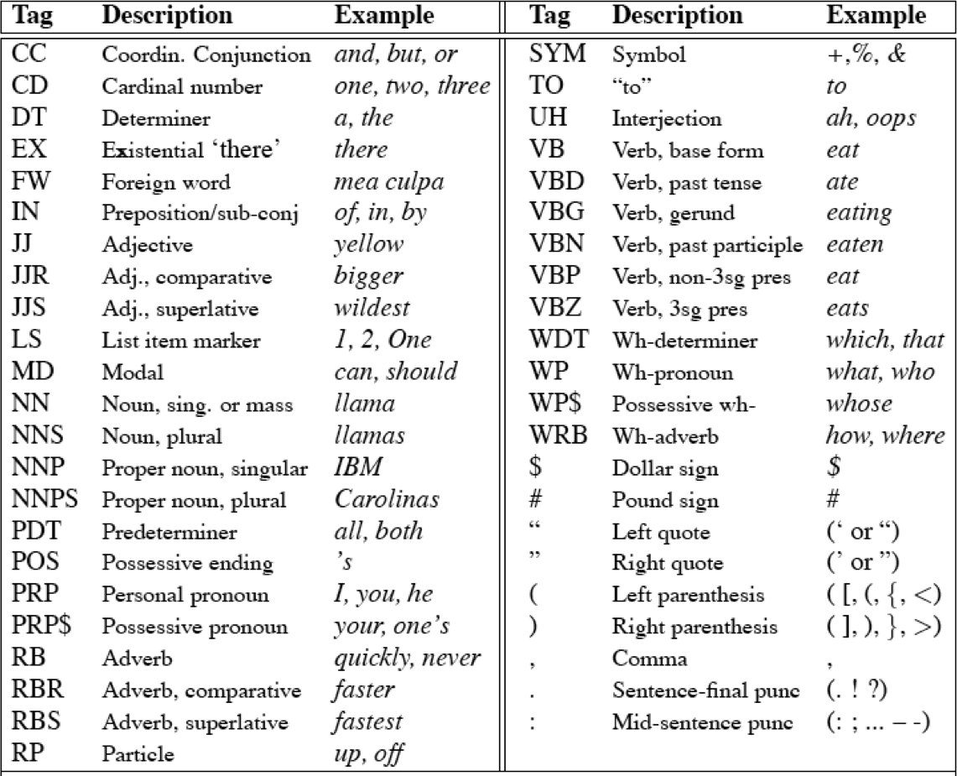
UPenn TreeBank POS tag set
Introduction to POS Tagging
Week 3: Lecture 4
6 / 18

Slide 7
Using the UPenn tagset
Example Sentence
The grand jury commented on a number of other topics.
POS tagged sentence
The/DT grand/JJ jury/NN commmented/VBD on/IN a/DT number/NN of/IN other/JJ topics/NNS ./.
Introduction to POS Tagging
Week 3: Lecture 4
7 / 18

Slide 8
Why is POS tagging hard?
Words often have more than one POS: back
The back door: back/JJ
On my back: back/NN
Win the voters back: back/RB
Promised to back the bill: back/VB
POS tagging problem
To determine the POS tag for a particular instance of a word
Introduction to POS Tagging
Week 3: Lecture 4
8 / 18

Slide 9
Ambiguous word types in the Brown Corpus
Ambiguity in the Brown corpus
40% of word tokens are ambiguous 12% of word types are ambiguous
Introduction to POS Tagging
Week 3: Lecture 4
9 / 18

Slide 10
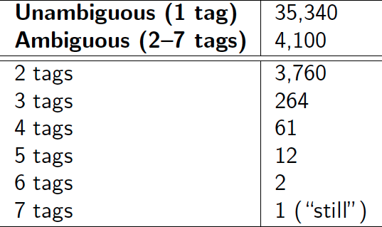
Ambiguous word types in the Brown Corpus
Ambiguity in the Brown corpus
40% of word tokens are ambiguous 12% of word types are ambiguous Breakdown of ambiguous word types:
Introduction to POS Tagging
Week 3: Lecture 4
9 / 18

Slide 11
How bad is the ambiguity problem?
One tag is usually more likely than the others.
Introduction to POS Tagging
Week 3: Lecture 4
10 / 18

Slide 12
How bad is the ambiguity problem?
One tag is usually more likely than the others.
In the Brown corpus, race is a noun 98% of the time, and a verb 2% of the time
A tagger for English that simply chooses the most likely tag for each word can achieve good performance
Any new approach should be compared against the unigram baseline (assigning each token to its most likely tag)
Introduction to POS Tagging
Week 3: Lecture 4
10 / 18

Slide 13
Deciding the correct POS
Can be difficult even for people
Mrs./NNP Shaefer/NNP never/RB got/VBD around/_ to/TO joining/VBG.
All/DT we/PRP gotta/VBN do/VB is/VBZ go/VB around/_ the/DT corner/NN.
Chateau/NNP Petrus/NNP costs/VBZ around/_ 2500/CD.
Introduction to POS Tagging
Week 3: Lecture 4

Slide 14
Deciding the correct POS
Can be difficult even for people
Mrs./NNP Shaefer/NNP never/RB got/VBD around/RP to/TO joining/VBG.
All/DT we/PRP gotta/VBN do/VB is/VBZ go/VB around/IN the/DT corner/NN.
Chateau/NNP Petrus/NNP costs/VBZ around/RB 2500/CD.
Introduction to POS Tagging
Week 3: Lecture 4

Slide 15
Relevant knowledge for POS tagging
The word itself
Some words may only be nouns, e.g. arrow
Some words are ambiguous, e.g. like, flies
Probabilities may help, if one tag is more likely than another
Local context
Two determiners rarely follow each other
Two base form verbs rarely follow each other
Determiner is almost always followed by adjective or noun
Introduction to POS Tagging
Week 3: Lecture 4
13 / 18

Slide 16
POS tagging: Two approaches
Rule-based Approach
Assign each word in the input a list of potential POS tags
Then winnow down this list to a single tag using hand-written rules
Statistical tagging
Get a training corpus of tagged text, learn the transformation rules from the most frequent tags (TBL tagger)
Probabilistic: Find the most likely sequence of tags T for a sequence of words W
Introduction to POS Tagging
Week 3: Lecture 4
14 / 18

Slide 17
TBL Tagger
Label the training set with most frequent tags
The can was rusted.
Introduction to POS Tagging
Week 3: Lecture 4
15 / 18

Slide 18
TBL Tagger
Label the training set with most frequent tags
The can was rusted.
The/DT can/MD was/VBD rusted/VBD.
Introduction to POS Tagging
Week 3: Lecture 4
15 / 18

Slide 19
TBL Tagger
Label the training set with most frequent tags
The can was rusted.
The/DT can/MD was/VBD rusted/VBD.
Add transformation rules to reduce training mistakes
MD →NN: DT_ VBD→VBN: VBD_
Introduction to POS Tagging
Week 3: Lecture 4
15 / 18

Slide 20
Probabilistic Tagging: Two different families of models
Problem at hand
We have some data {(d, c)} of paired observations d and hidden classes c.
Introduction to POS Tagging
Week 3: Lecture 4
16 / 18

Slide 21
Probabilistic Tagging: Two different families of models
Problem at hand
We have some data {(d, c)} of paired observations d and hidden classes c.
Different instances of d and c
Part-of-Speech Tagging:
Introduction to POS Tagging
Week 3: Lecture 4
16 / 18

Slide 22
Probabilistic Tagging: Two different families of models
Problem at hand
We have some data {(d, c)} of paired observations d and hidden classes c.
Different instances of d and c
Part-of-Speech Tagging: words are observed and tags are hidden.
Text Classification:
Introduction to POS Tagging
Week 3: Lecture 4
16 / 18

Slide 23
Probabilistic Tagging: Two different families of models
Problem at hand
We have some data {(d, c)} of paired observations d and hidden classes c.
Different instances of d and c
Part-of-Speech Tagging: words are observed and tags are hidden.
Text Classification: sentences/documents are observed and the category is hidden.
Introduction to POS Tagging
Week 3: Lecture 4
16 / 18

Slide 24
Probabilistic Tagging: Two different families of models
Problem at hand
We have some data {(d, c)} of paired observations d and hidden classes c.
Different instances of d and c
Part-of-Speech Tagging: words are observed and tags are hidden.
Text Classification: sentences/documents are observed and the category is hidden.
Categories can be positive/negative for sentiments .. sports/politics/business for documents ...
Introduction to POS Tagging
Week 3: Lecture 4
16 / 18

Slide 25
Probabilistic Tagging: Two different families of models
Problem at hand
We have some data {(d, c)} of paired observations d and hidden classes c.
Different instances of d and c
Part-of-Speech Tagging: words are observed and tags are hidden.
Text Classification: sentences/documents are observed and the category is hidden.
Categories can be positive/negative for sentiments .. sports/politics/business for documents ...
What gives rise to the two families?
Whether they generate the observed data from hidden stuff or the hidden structure given the data?
Introduction to POS Tagging
Week 3: Lecture 4
16 / 18

Slide 26
Generative vs. Conditional Models
Generative (Joint) Models
Generate the observed data from hidden stuff, i.e. put a probability over the observations given the class: P(d, c) in terms of P(d|c)
Introduction to POS Tagging
Week 3: Lecture 4
17 / 18

Slide 27
Generative vs. Conditional Models
Generative (Joint) Models
Generate the observed data from hidden stuff, i.e. put a probability over the observations given the class: P(d, c) in terms of P(d|c)
e.g. Naïve Bayes’ classifiers, Hidden Markov Models etc.
Introduction to POS Tagging
Week 3: Lecture 4
17 / 18

Slide 28
Generative vs. Conditional Models
Generative (Joint) Models
Generate the observed data from hidden stuff, i.e. put a probability over the observations given the class: P(d, c) in terms of P(d|c)
e.g. Naïve Bayes’ classifiers, Hidden Markov Models etc.
Discriminative (Conditional) Models
Take the data as given, and put a probability over hidden structure given the data: P(c|d)
Introduction to POS Tagging
Week 3: Lecture 4
17 / 18

Slide 29
Generative vs. Conditional Models
Generative (Joint) Models
Generate the observed data from hidden stuff, i.e. put a probability over the observations given the class: P(d, c) in terms of P(d|c)
e.g. Naïve Bayes’ classifiers, Hidden Markov Models etc.
Discriminative (Conditional) Models
Take the data as given, and put a probability over hidden structure given the data: P(c|d)
e.g. Logistic regression, maximum entropy models, conditional random fields
Introduction to POS Tagging
Week 3: Lecture 4
17 / 18

Slide 30
Generative vs. Conditional Models
Generative (Joint) Models
Generate the observed data from hidden stuff, i.e. put a probability over the observations given the class: P(d, c) in terms of P(d|c)
e.g. Naïve Bayes’ classifiers, Hidden Markov Models etc.
Discriminative (Conditional) Models
Take the data as given, and put a probability over hidden structure given the data: P(c|d)
e.g. Logistic regression, maximum entropy models, conditional random fields
SVMs, perceptron, etc. are discriminative classifiers but not directly probabilistic
Introduction to POS Tagging
Week 3: Lecture 4
17 / 18

Slide 31
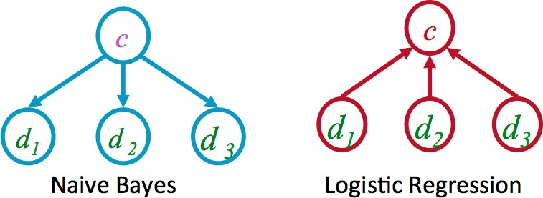
Generative vs. Discriminative Models
Introduction to POS Tagging
Week 3: Lecture 4
18 / 18

Slide 32
Generative vs. Discriminative Models
Joint vs. conditional likelihood
A joint model gives probabilities P(d, c) and tries to maximize this joint likelihood.
A conditional model gives probabilities P(c|d), taking the data as given and modeling only the conditional probability of the class.
Introduction to POS Tagging
Week 3: Lecture 4
18 / 18

Slide 33
Hidden Markov Models for POS Tagging
Pawan Goyal
CSE, IITKGP
Week 3: Lecture 5
Hidden Markov Models for POS Tagging
Week 3: Lecture 5
1 / 17

Slide 34
Probabilistic Tagging
W = w₁ . . . w_{n} - words in the corpus (observed)
T = t₁ . . . t_{n} - the corresponding tags (unknown)
Hidden Markov Models for POS Tagging
Week 3: Lecture 5
2 / 17

Slide 35
Probabilistic Tagging
W = w₁ . . . w_{n} - words in the corpus (observed)
T = t₁ . . . t_{n} - the corresponding tags (unknown)
Tagging: Probabilistic View (Generative Model)
Find
_{T}ˆ
= argmax_{T}P(T|W)
Hidden Markov Models for POS Tagging
Week 3: Lecture 5
2 / 17

Slide 36
Probabilistic Tagging
W = w₁ . . . w_{n} - words in the corpus (observed)
T = t₁ . . . t_{n} - the corresponding tags (unknown)
Tagging: Probabilistic View (Generative Model)
Find
_{T}ˆ
= argmax_{T}P(T|W)
_{argmaxT} P(W|T)P(T)
=
P(W)
Hidden Markov Models for POS Tagging
Week 3: Lecture 5
2 / 17

Slide 37
Probabilistic Tagging
W = w₁ . . . w_{n} - words in the corpus (observed)
T = t₁ . . . t_{n} - the corresponding tags (unknown)
Tagging: Probabilistic View (Generative Model)
Find
_{T}ˆ
= argmax_{T}P(T|W)
_{argmaxT} P(W|T)P(T)
=
P(W)
= argmax_{T}P(W|T)P(T)
Hidden Markov Models for POS Tagging
Week 3: Lecture 5
2 / 17

Slide 38
Probabilistic Tagging
W = w₁ . . . w_{n} - words in the corpus (observed)
T = t₁ . . . t_{n} - the corresponding tags (unknown)
Tagging: Probabilistic View (Generative Model)
Find
_{T}ˆ
= argmax_{T}P(T|W)
_{argmaxT} P(W|T)P(T)
=
P(W)
= argmax_{T}P(W|T)P(T)
.
= argmax P
(w |w . . . w , t . . . t )P(t |
t . . . t )
T
i 1 i−1 1 i i 1 i−1
i
Hidden Markov Models for POS Tagging
Week 3: Lecture 5
2 / 17

Slide 39
Further simplifications
.
ˆ
T = argmax P
(w |w . . . w , t . . . t )P(t |t . . . t )
T i 1 i−1 1 i i 1 i−1
i
The probability of a word appearing depends only on its own POS tag
Hidden Markov Models for POS Tagging
Week 3: Lecture 5
3 / 17

Slide 40
Further simplifications
.
ˆ
T = argmax P
(w |w . . . w , t . . . t )P(t |t . . . t )
T i 1 i−1 1 i i 1 i−1
i
The probability of a word appearing depends only on its own POS tag
P(w_{i}|w₁ . . . w_{i−1}, t₁ . . . t_{i}) ≈ P(w_{i}|t_{i})
Bigram assumption: the probability of a tag appearing depends only on the previous tag
Hidden Markov Models for POS Tagging
Week 3: Lecture 5
3 / 17

Slide 41
Further simplifications
.
ˆ
T = argmax P
(w |w . . . w , t . . . t )P(t |t . . . t )
T i 1 i−1 1 i i 1 i−1
i
The probability of a word appearing depends only on its own POS tag
P(w_{i}|w₁ . . . w_{i−1}, t₁ . . . t_{i}) ≈ P(w_{i}|t_{i})
Bigram assumption: the probability of a tag appearing depends only on the previous tag
P(t_{i}|t₁ . . . t_{i−1}) ≈ P(t_{i}|t_{i−1})
Hidden Markov Models for POS Tagging
Week 3: Lecture 5
3 / 17

Slide 42
Further simplifications
.
ˆ
T = argmax P
(w |w . . . w , t . . . t )P(t |t . . . t )
T i 1 i−1 1 i i 1 i−1
i
The probability of a word appearing depends only on its own POS tag
P(w_{i}|w₁ . . . w_{i−1}, t₁ . . . t_{i}) ≈ P(w_{i}|t_{i})
Bigram assumption: the probability of a tag appearing depends only on the previous tag
P(t_{i}|t₁ . . . t_{i−1}) ≈ P(t_{i}|t_{i−1})
Using these simplifications:
.
ˆ
T = argmax P
(w |t )P(t |t )
T
i i i i−1
i
Hidden Markov Models for POS Tagging
Week 3: Lecture 5
3 / 17

Slide 43
Computing the probability values
Tag Transition probabilities p(t_{i}|t_{i−1})
C(t_{i−1}, t_{i}) C(t_{i−1})
P(t_{i}|t_{i−1}) =
^{C(DT, NN)} 56
, 509
P(NN|
DT) =
=
= 0.49
C(DT) 116, 454
Hidden Markov Models for POS Tagging
Week 3: Lecture 5
4 / 17

Slide 44
Computing the probability values
Tag Transition probabilities p(t_{i}|t_{i−1})
C(t_{i−1}, t_{i}) C(t_{i−1})
P(t_{i}|t_{i−1}) =
^{C(DT, NN)} 56
, 509
P(NN|
DT) =
=
= 0.49
C(DT) 116, 454
Word Likelihood probabilities p(w_{i}|t_{i})
C(t_{i}, w_{i})
P(w |t ) =
i i
C(t_{i})
^{C(VBZ, is)} 10
, 073
P(is|VBZ) =
=
= 0.47
C(VBZ) 21, 627
Hidden Markov Models for POS Tagging
Week 3: Lecture 5
4 / 17

Slide 45
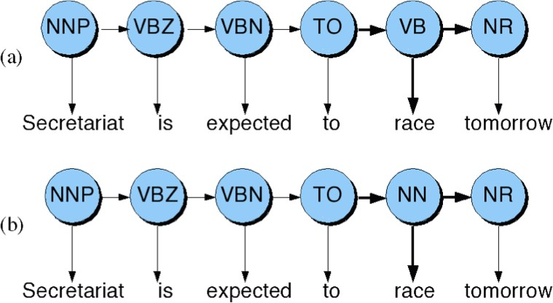
Disambiguating “race”
Hidden Markov Models for POS Tagging
Week 3: Lecture 5
5 / 17

Slide 46
Disambiguating “race”
Difference in probability due to P(VB|TO) vs. P(NN|TO)
P(race|VB) vs. P(race|NN) P(NR|VB) vs. P(NR|NN)
Hidden Markov Models for POS Tagging
Week 3: Lecture 5
6 / 17

Slide 47
Disambiguating “race”
Difference in probability due to P(VB|TO) vs. P(NN|TO)
P(race|VB) vs. P(race|NN) P(NR|VB) vs. P(NR|NN)
After computing the probabilities
P(NN|TO)P(NR|NN)P(race|NN) = 0.0047 × 0.0012 × 0.00057 =
0.00000000032
P(VB|TO)P(NR|VB)P(race|VB) = 0.83 × 0.0027 × 0.00012 = 0.00000027
Hidden Markov Models for POS Tagging
Week 3: Lecture 5
6 / 17

Slide 48
What is this model?
Hidden Markov Models for POS Tagging
Week 3: Lecture 5
7 / 17

Slide 49
What is this model?
This is a Hidden Markov Model
Hidden Markov Models for POS Tagging
Week 3: Lecture 5
7 / 17

Slide 50
Hidden Markov Models
Tag Transition probabilities p(t_{i}|t_{i−1})
Word Likelihood probabilities (emissions) p(w_{i}|t_{i})
Hidden Markov Models for POS Tagging
Week 3: Lecture 5
8 / 17

Slide 51
Hidden Markov Models
Tag Transition probabilities p(t_{i}|t_{i−1})
Word Likelihood probabilities (emissions) p(w_{i}|t_{i})
What we have described with these probabilities is a hidden markov model.
Let us quickly introduce the Markov Chain, or observable Markov Model.
Hidden Markov Models for POS Tagging
Week 3: Lecture 5
8 / 17

Slide 52
Markov Chain = First-order Markov Model
Weather example
Three types of weather: sunny, rainy, foggy
Hidden Markov Models for POS Tagging
Week 3: Lecture 5
9 / 17

Slide 53
Markov Chain = First-order Markov Model
Weather example
Three types of weather: sunny, rainy, foggy
q_{n}: variable denoting the weather on the n^{th} day
Hidden Markov Models for POS Tagging
Week 3: Lecture 5
9 / 17

Slide 54
Markov Chain = First-order Markov Model
Weather example
Three types of weather: sunny, rainy, foggy
q_{n}: variable denoting the weather on the n^{th} day
We want to find the following conditional probabilities:
P(q_{n}|q_{n−1}, q_{n−2},..., q₁)
Hidden Markov Models for POS Tagging
Week 3: Lecture 5
9 / 17

Slide 55
Markov Chain = First-order Markov Model
Weather example
Three types of weather: sunny, rainy, foggy
q_{n}: variable denoting the weather on the n^{th} day
We want to find the following conditional probabilities:
P(q_{n}|q_{n−1}, q_{n−2},..., q₁)
First-order Markov Assumption
P(q_{n}|q_{n−1}, q_{n−2},..., q₁) = P(q_{n}|q_{n−1})
Hidden Markov Models for POS Tagging
Week 3: Lecture 5
9 / 17

Slide 56
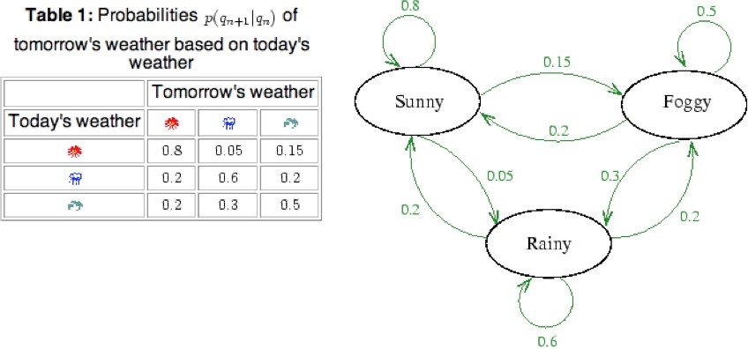
Markov Chain Transition Table
Hidden Markov Models for POS Tagging
Week 3: Lecture 5

Slide 57
Using Markov Chain
Given that today the weather is sunny, what is the probability that tomorrow is sunny and day after is rainy?
Hidden Markov Models for POS Tagging
Week 3: Lecture 5
11 / 17

Slide 58
Using Markov Chain
Given that today the weather is sunny, what is the probability that tomorrow is sunny and day after is rainy?
P(q₂ = sunny, q₃ = rainy|q₁ = sunny)
Hidden Markov Models for POS Tagging
Week 3: Lecture 5
11 / 17

Slide 59
Using Markov Chain
Given that today the weather is sunny, what is the probability that tomorrow is sunny and day after is rainy?
P(q₂ = sunny, q₃ = rainy|q₁ = sunny)
= P(q₃ = rainy|q₂ = sunny, q₁ = sunny) × P(q₂ = sunny|q₁ = sunny)
Hidden Markov Models for POS Tagging
Week 3: Lecture 5
11 / 17

Slide 60
Using Markov Chain
Given that today the weather is sunny, what is the probability that tomorrow is sunny and day after is rainy?
P(q₂ = sunny, q₃ = rainy|q₁ = sunny)
= P(q₃ = rainy|q₂ = sunny, q₁ = sunny) × P(q₂ = sunny|q₁ = sunny)
= P(q₃ = rainy|q₂ = sunny) × P(q₂ = sunny|q₁ = sunny)
= 0.05 × 0.8
= 0.04
Hidden Markov Models for POS Tagging
Week 3: Lecture 5
11 / 17

Slide 61
Hidden Markov Model
For Markov chains, the output symbols are the same as the states
‘sunny’ weather is both observable and state
Hidden Markov Models for POS Tagging
Week 3: Lecture 5
12 / 17

Slide 62
Hidden Markov Model
For Markov chains, the output symbols are the same as the states
‘sunny’ weather is both observable and state
But in POS tagging
NPTEL
Hidden Markov Models for POS Tagging
Week 3: Lecture 5
12 / 17

Slide 63
Hidden Markov Model
For Markov chains, the output symbols are the same as the states
‘sunny’ weather is both observable and state
But in POS tagging
The output symbols are words
Hidden Markov Models for POS Tagging
Week 3: Lecture 5
12 / 17

Slide 64
Hidden Markov Model
For Markov chains, the output symbols are the same as the states
‘sunny’ weather is both observable and state
But in POS tagging
The output symbols are words
But the hidden states are POS tags
A Hidden Markov Model is an extension of a Markov chain in which the output symbols are not the same as the states
We don’t know which state we are in
Hidden Markov Models for POS Tagging
Week 3: Lecture 5
12 / 17

Slide 65
Hidden Markov Models (HMMs)
Elements of an HMM model
A set of states (here: the tags) An output alphabet (here: words)
Initial state (here: beginning of sentence) State transition probabilities (here p(t_{n}|t_{n−1})) Symbol emission probabilities (here p(w_{i}|t_{i}))
Hidden Markov Models for POS Tagging
Week 3: Lecture 5

Slide 66
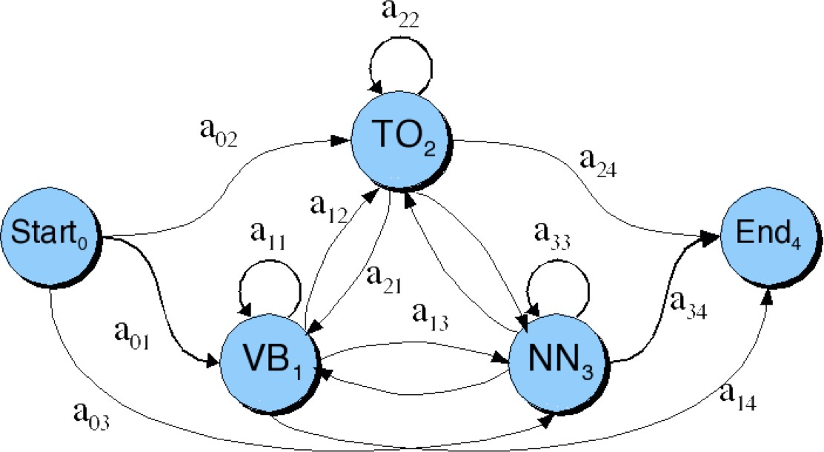
Graphical Representation
When tagging a sentence, we are walking through the state graph:
Edges are labeled with the state transition probabilities: p(t_{n}|t_{n−1})
Hidden Markov Models for POS Tagging
Week 3: Lecture 5

Slide 67
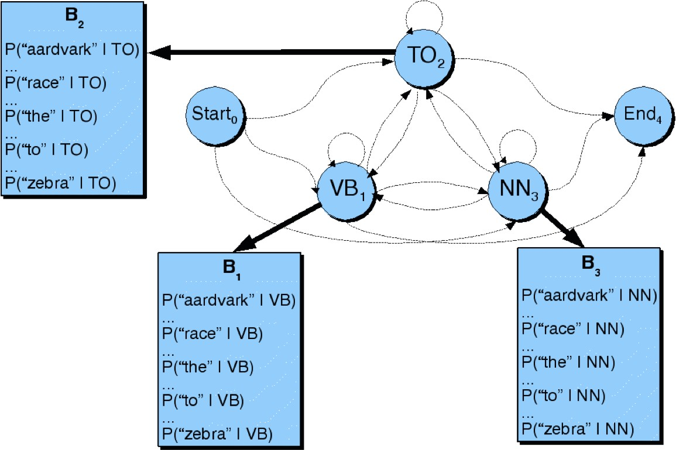
Graphical Representation
At each state we emit a word: P(w_{n}|t_{n})
Hidden Markov Models for POS Tagging
Week 3: Lecture 5

Slide 68
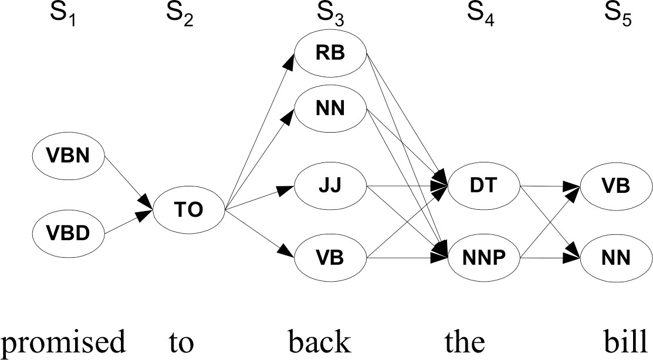
Walking through the states: best path
Hidden Markov Models for POS Tagging
Week 3: Lecture 5

Slide 69
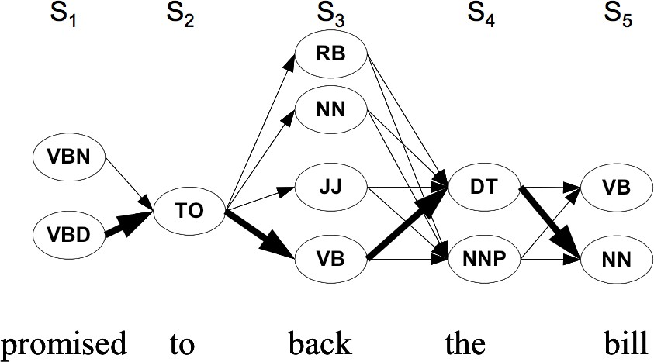
Walking through the states: best path
Hidden Markov Models for POS Tagging
Week 3: Lecture 5

